Slide 1
JavaScript: Control Statements II
Outline
Introduction
Essentials of Counter-Controlled Repetition
for Repetition Statement
Examples Using the for Statement
switch Multiple-Selection Statement
do…while Repetition Statement
break and continue Statements
Labeled break and continue Statements
Logical Operators
Summary of Structured Programming

Slide 2
Objectives
In this lesson, you will learn:
To be able to use the for and do…while repetition statements to execute statements in a program repeatedly.
To understand multiple selection using the switch selection statement.
To be able to use the break and continue program-control statements.
To be able to use the logical operators.

Slide 3
1 Introduction
Continuation of Chapter 8
Theory and principles of structured programming

Slide 4
2 Essentials of Counter-Controlled Repetition
Counter-controlled repetition
Name of a control
Initial value
Increment or decrement
Final value

Slide 5
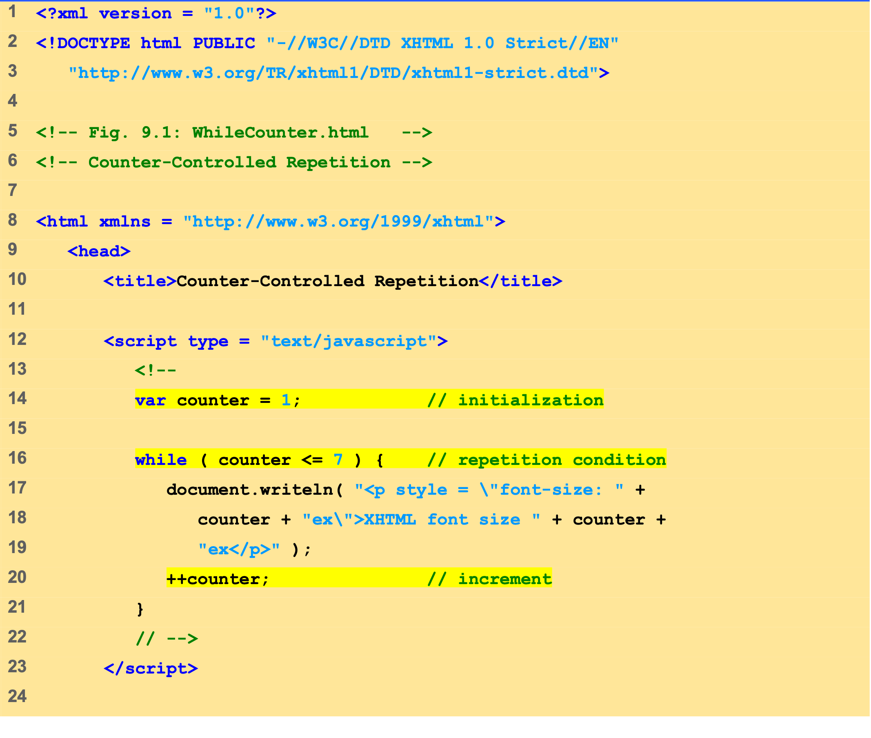
WhileCounter.html (1 of 2)

Slide 6
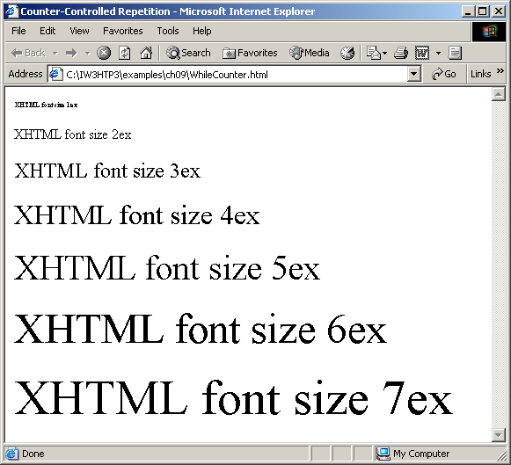
WhileCounter.html (2 of 2)

Slide 7
3 for Repetition Statement
for repetition statement
Handles all the details of counter-controlled repetition
for structure header
The first line

Slide 8
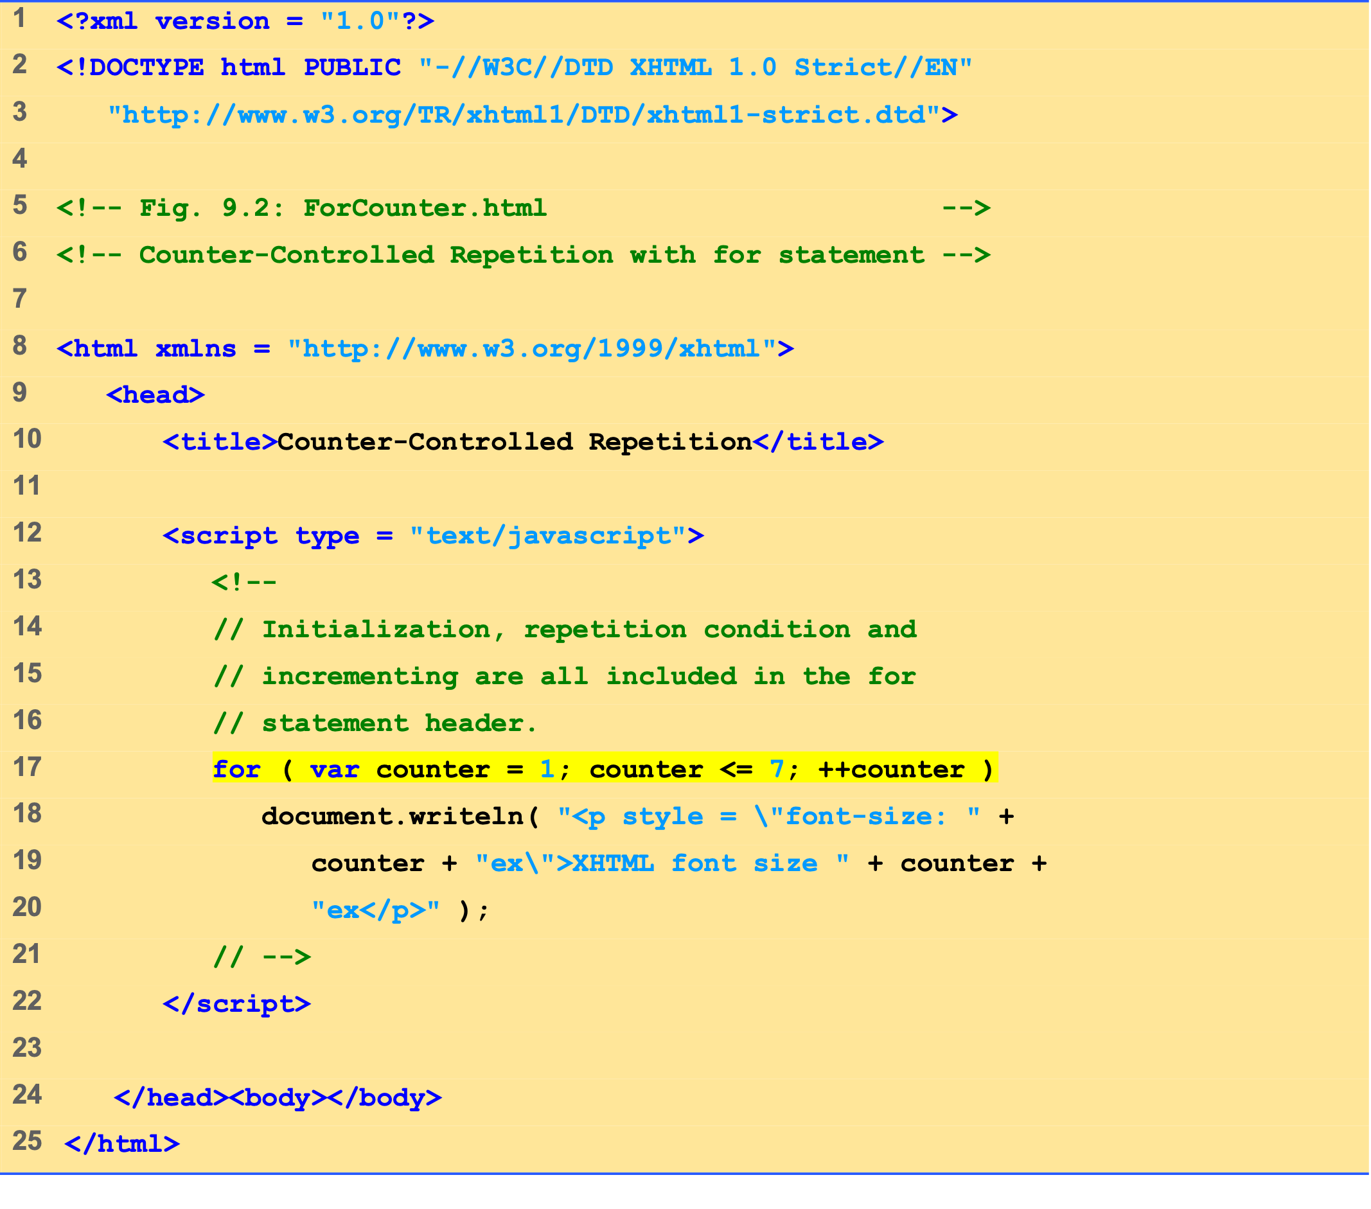
ForCounter.html (1 of 1)

Slide 9


Slide 10
3 for Repetition Statement
for
keyword
Control variable
name
Final value
of control variable
for which the condition is true
for
(
var
counter =
1
; counter <=
7
; ++counter )
Initial value
of control variable
Increment
of control variable
Loop-continuation condition

Slide 11
3 for Repetition Statement
Establish
initial value
of control
variable.
var
counter =
1
true
document.writeln(
counter <=
7
"<p style=\"font-size: "
++counter
+ counter +
Increment
"ex\">XHTML font size "
+
false
counter +
"ex</p>"
);
the control
variable.
Determine
Body of loop
if
final value
(this may be many
of control
statements)
variable
has been
reached.

Slide 12
4 Examples Using the for Statement
Summation with for
Compound interest calculation with for loop
Math object
Method pow
Method round

Slide 13
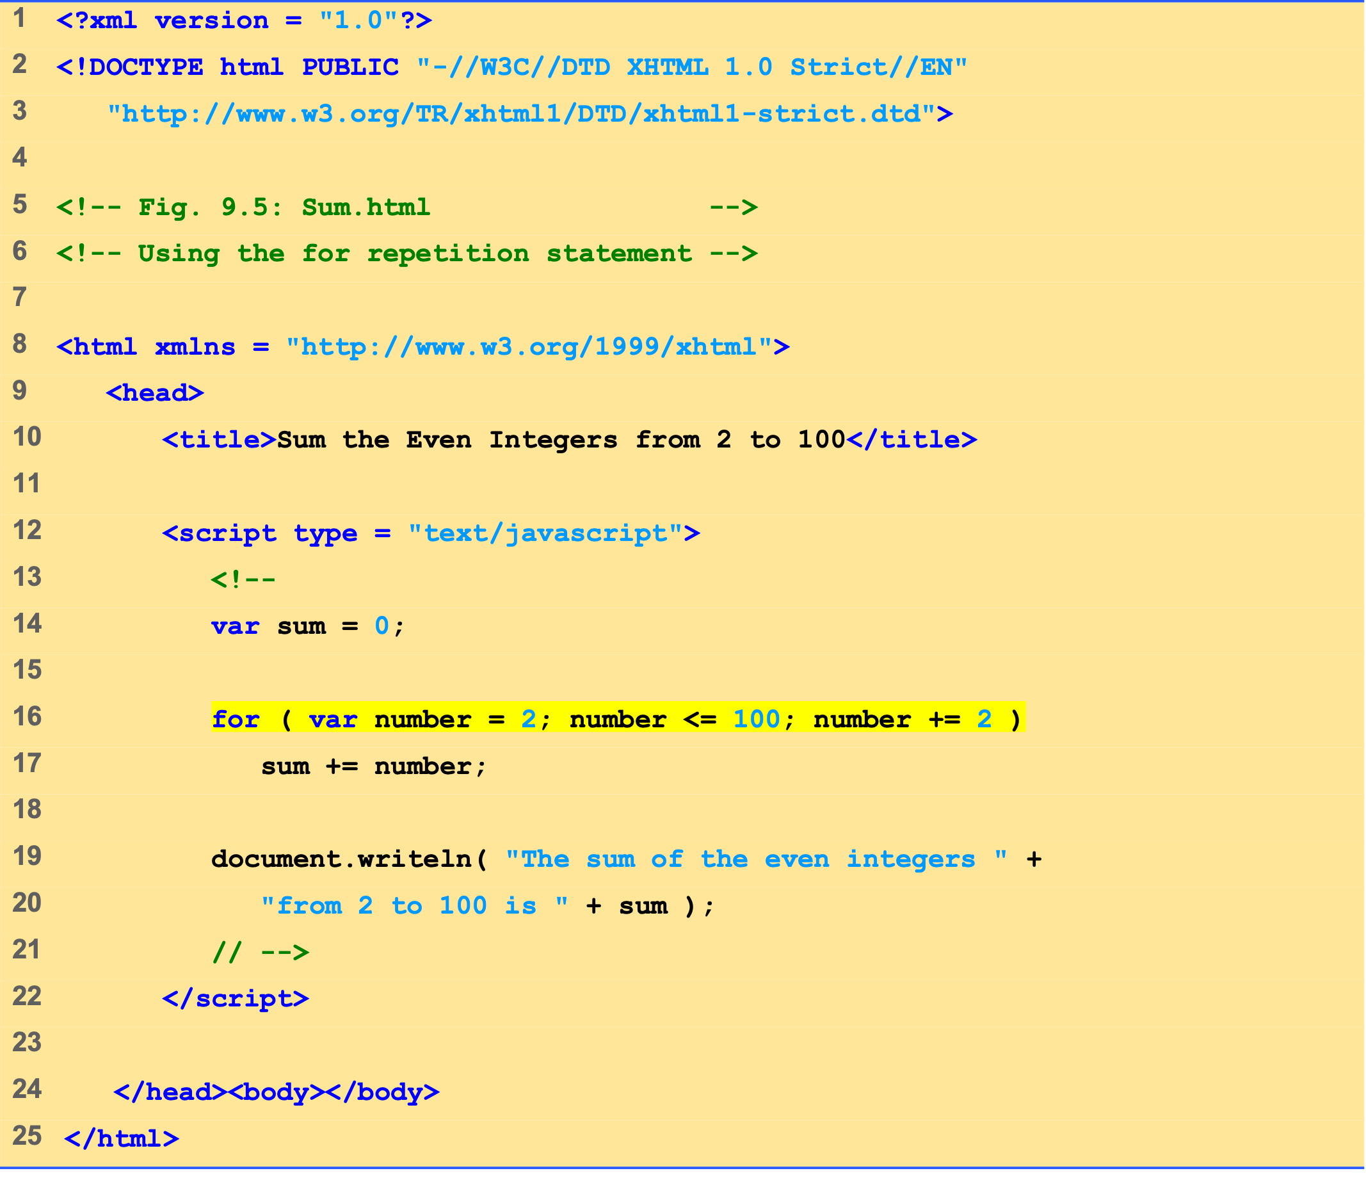
Sum.html (1 of 1)

Slide 14
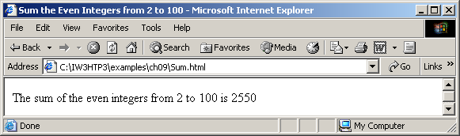

Slide 15
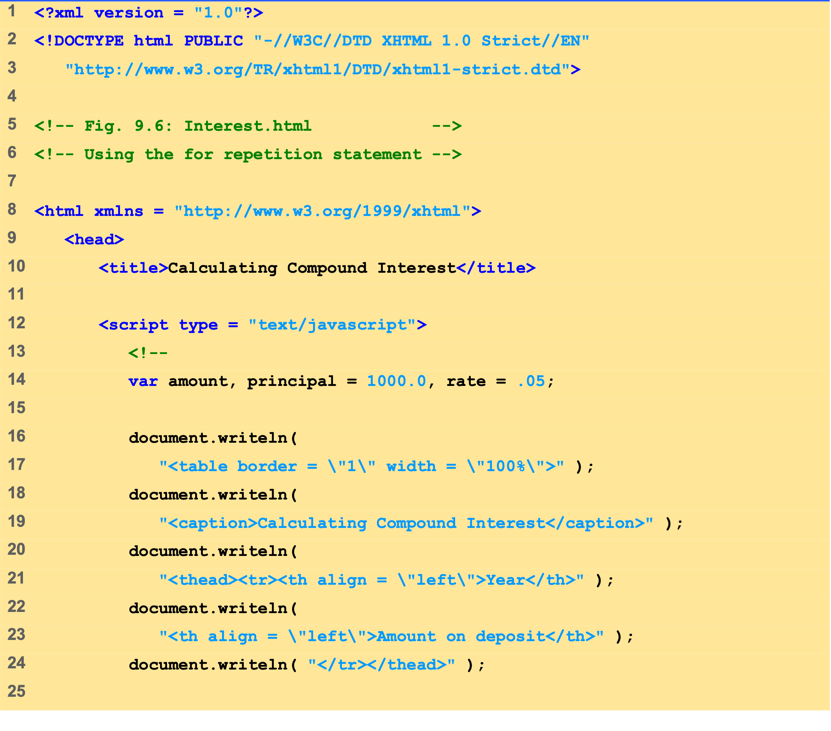
Interest.html (1 of 2)

Slide 16
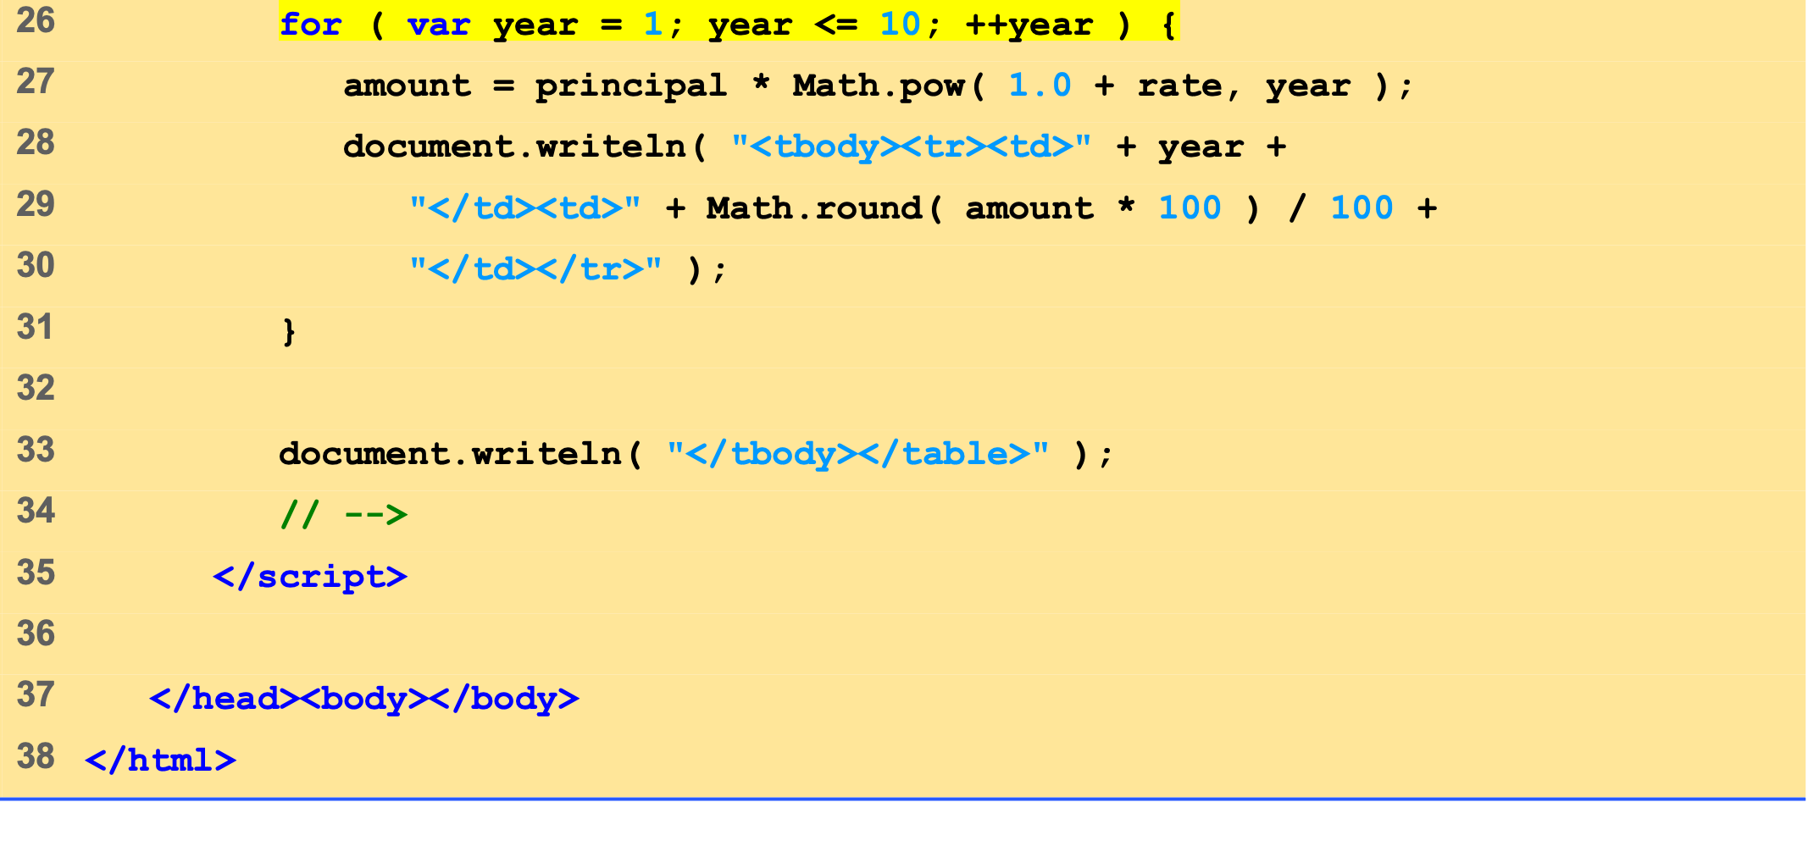
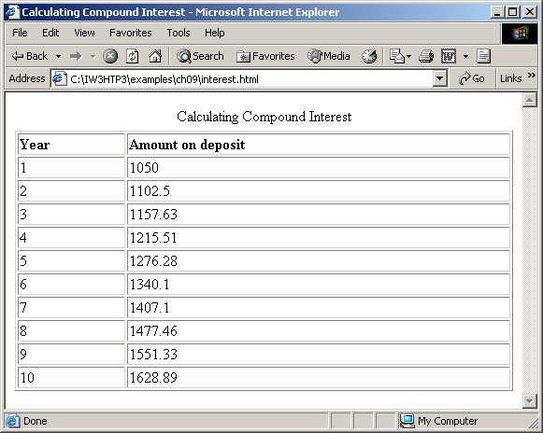
Interest.html (2 of 2)

Slide 17
5 switch Multiple-Selection Statement
Controlling expression
Case labels
Default case

Slide 18
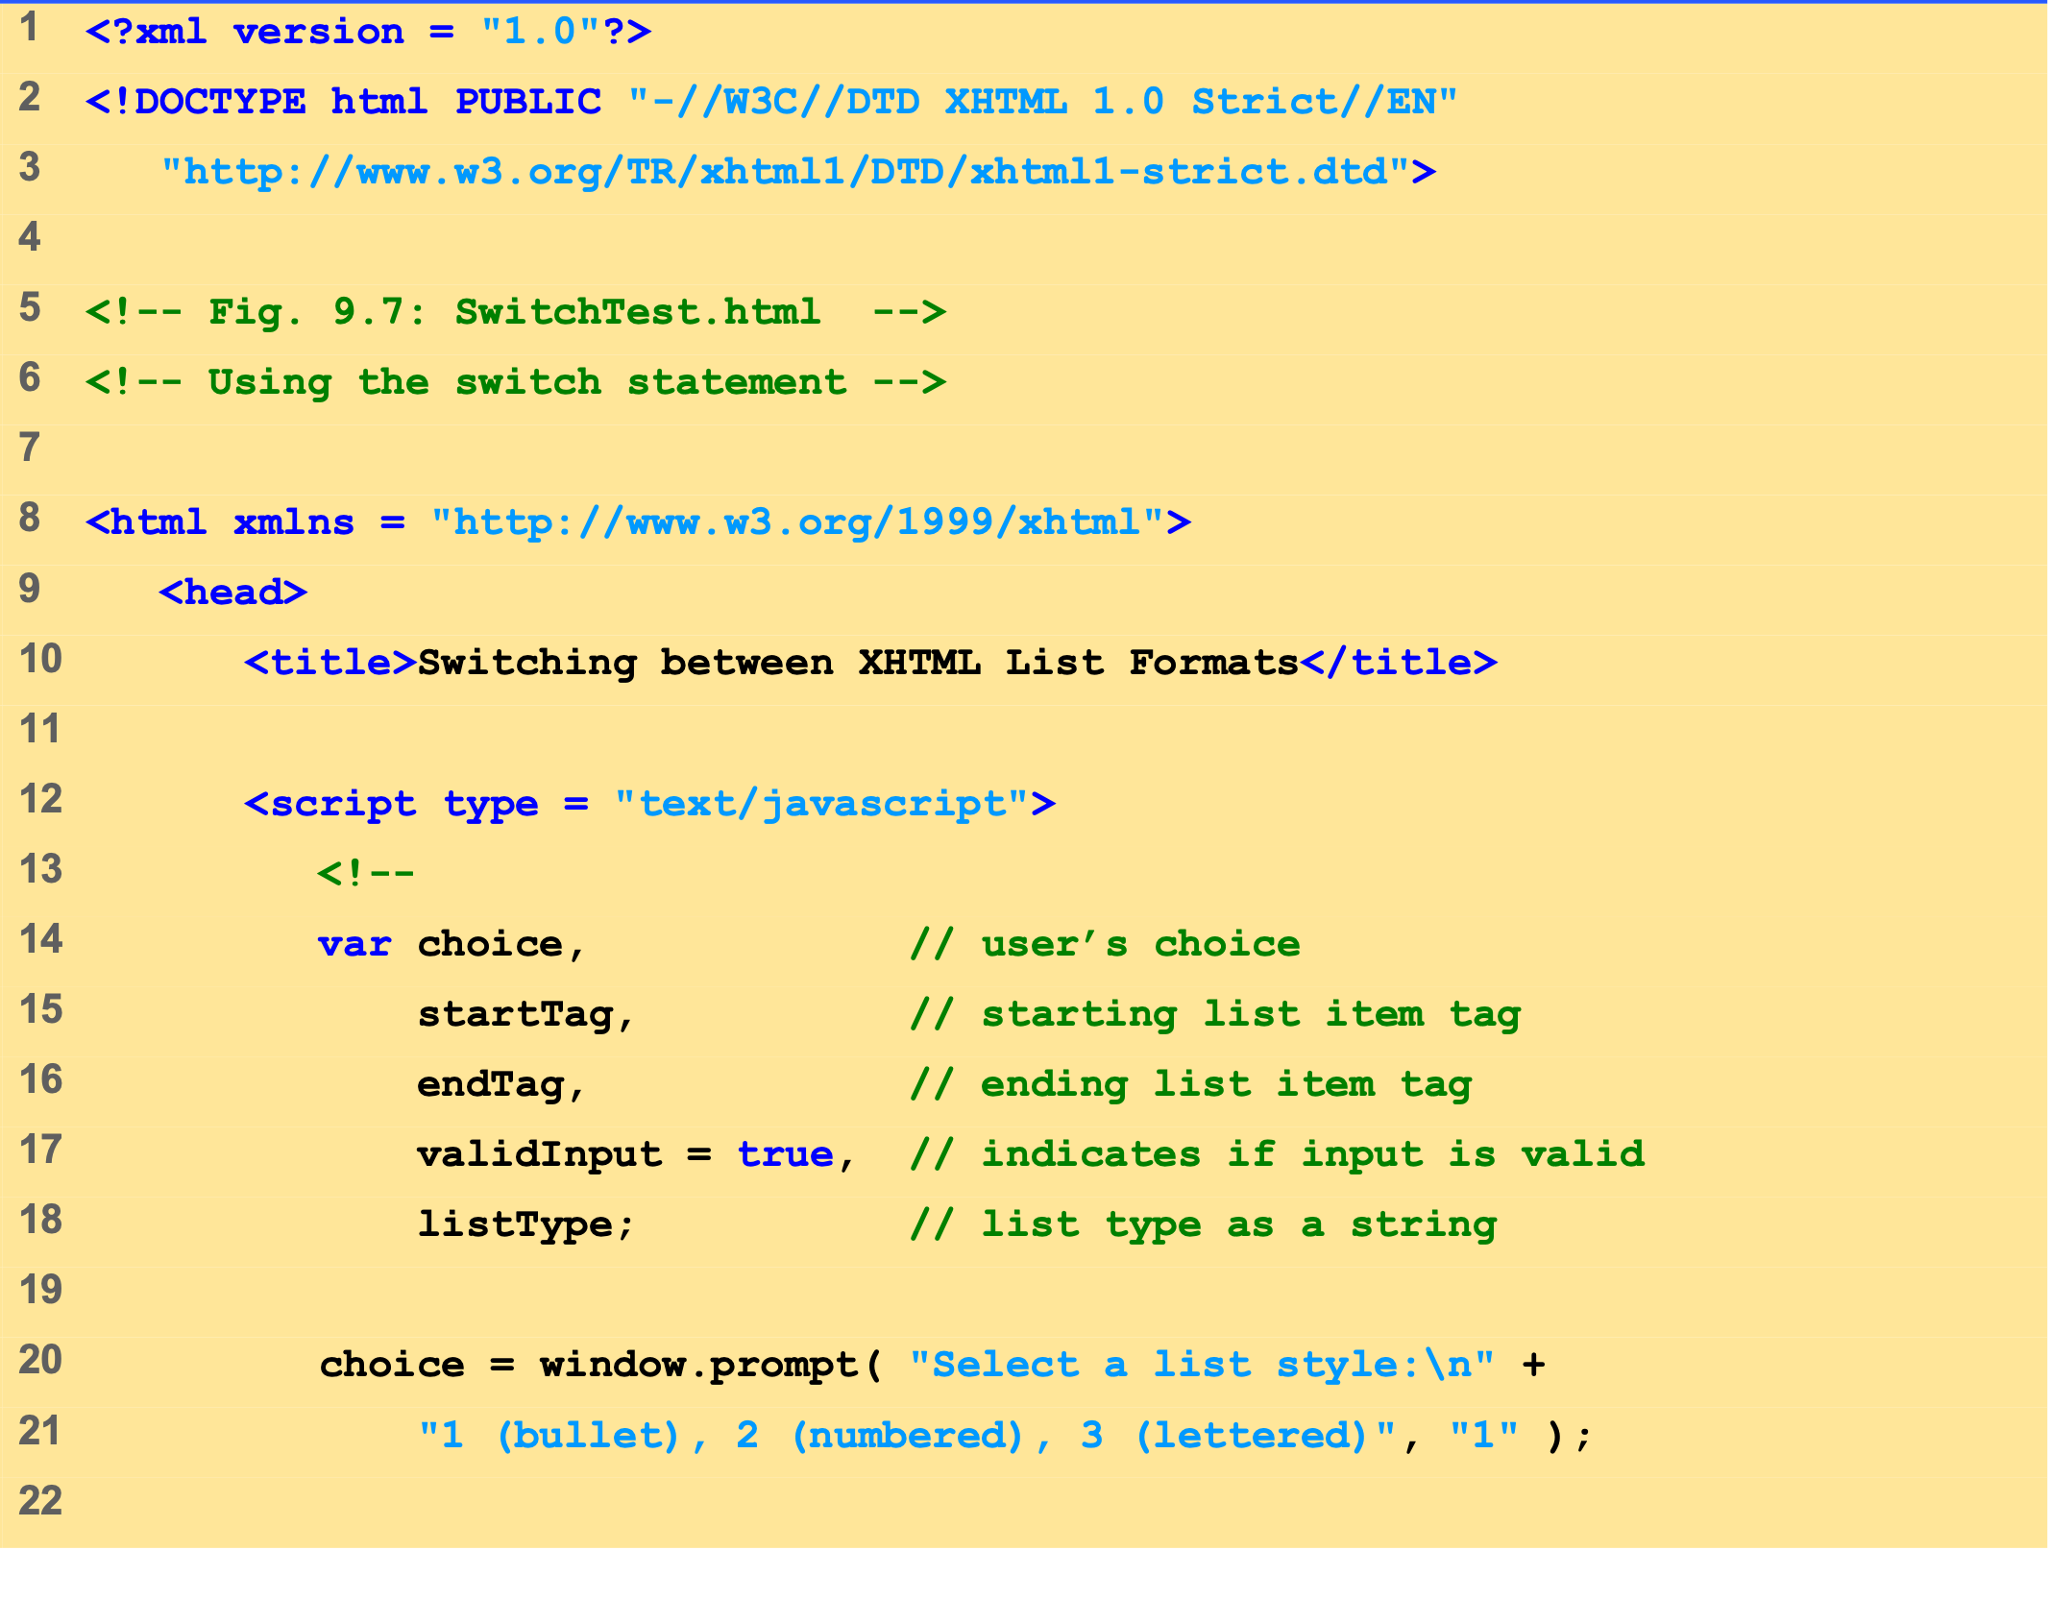
SwitchTest.html (1 of 3)

Slide 19
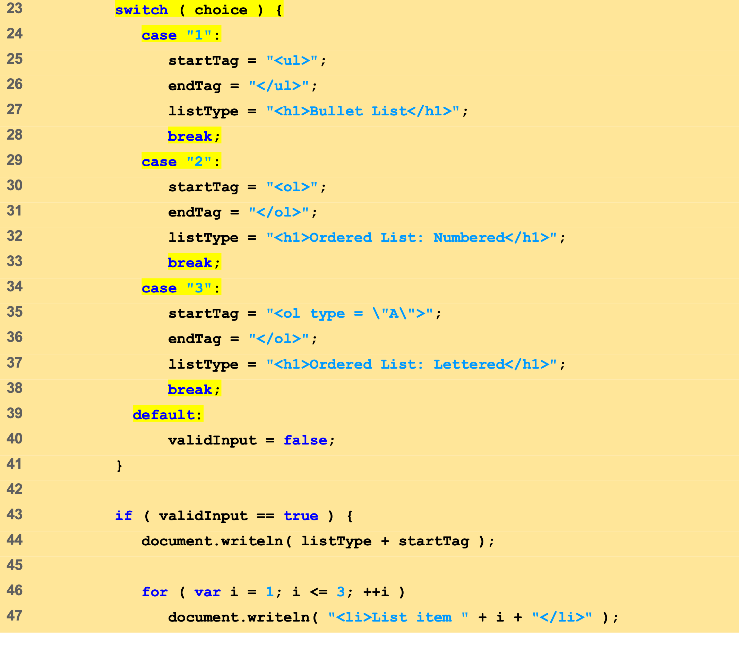
SwitchTest.html (2 of 3)

Slide 20
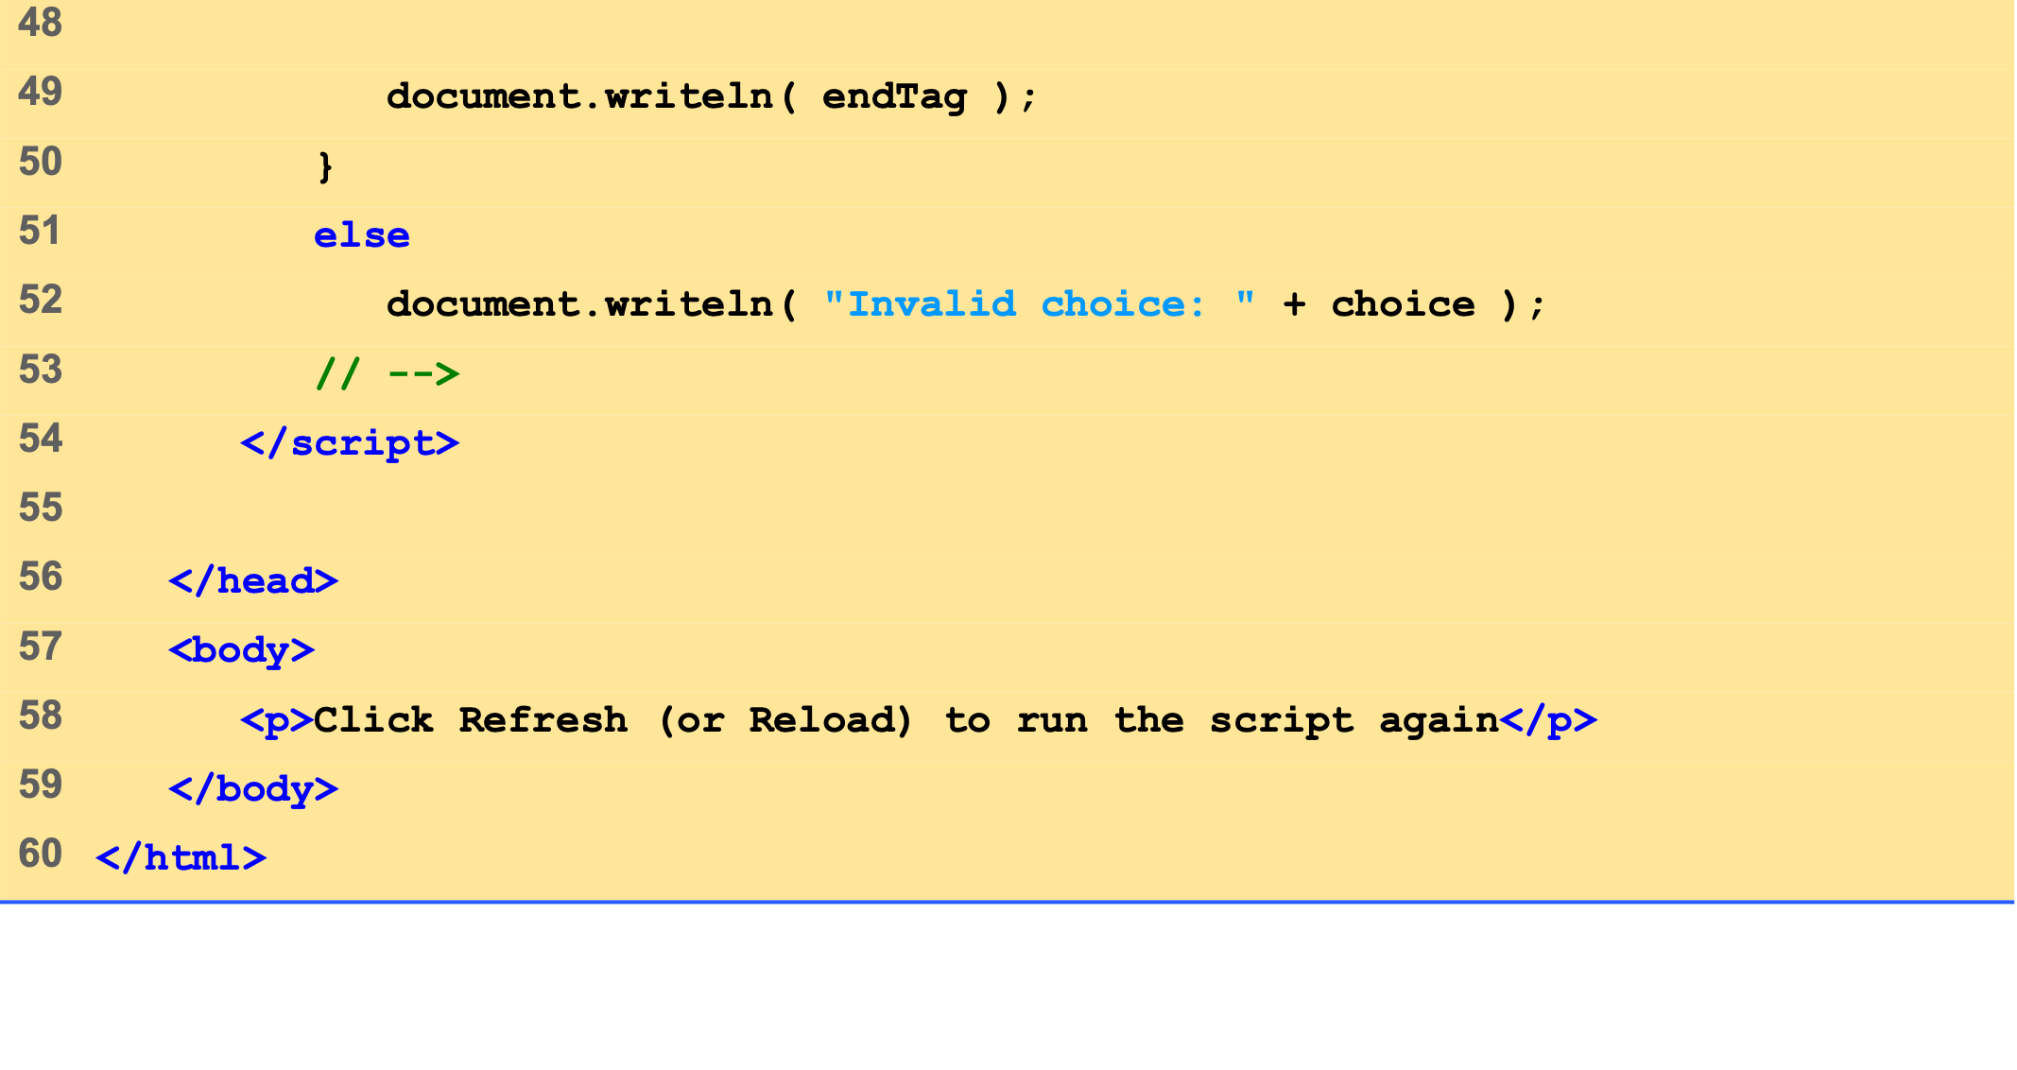
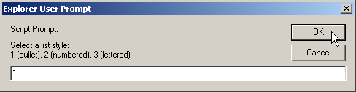
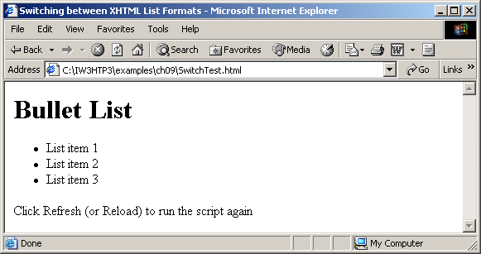
SwitchTest.html (3 of 3)

Slide 21
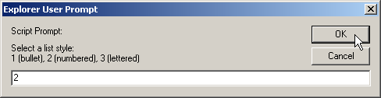
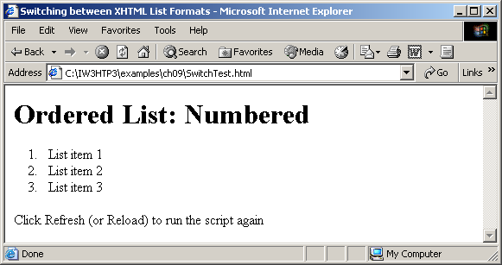

Slide 22
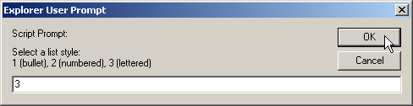
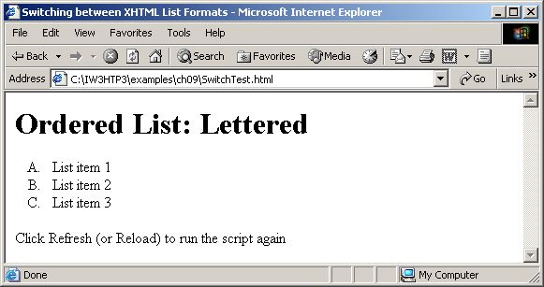

Slide 23
5 switch Multiple-Selection Statement
case
a
true
case
a action(s)
break
false
case
b
true
case
b action(s)
break
false
.
.
.
case
z
true
case
z action(s)
break
false
default
action(s)

Slide 24
6 do…while Repetition Statement
Similar to the while statement
Tests the loop continuation condition after the loop body executes
Loop body always executes at least once

Slide 25
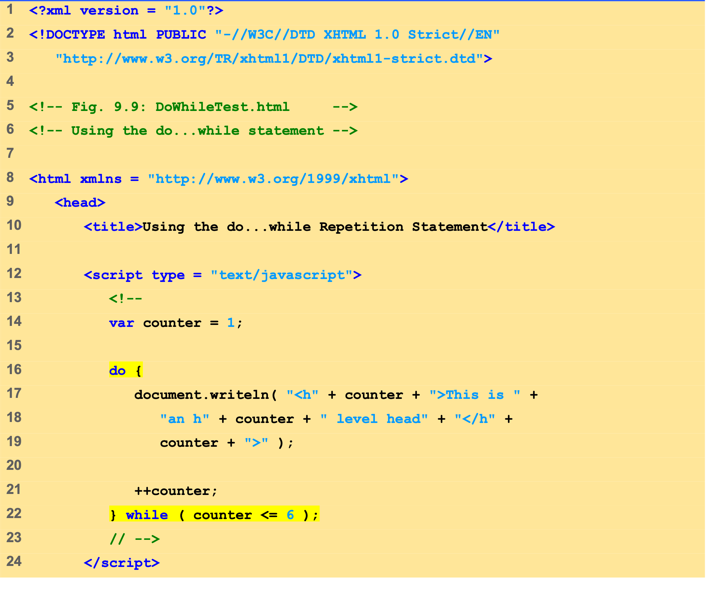
DoWhileTest.html (1 of 2)

Slide 26
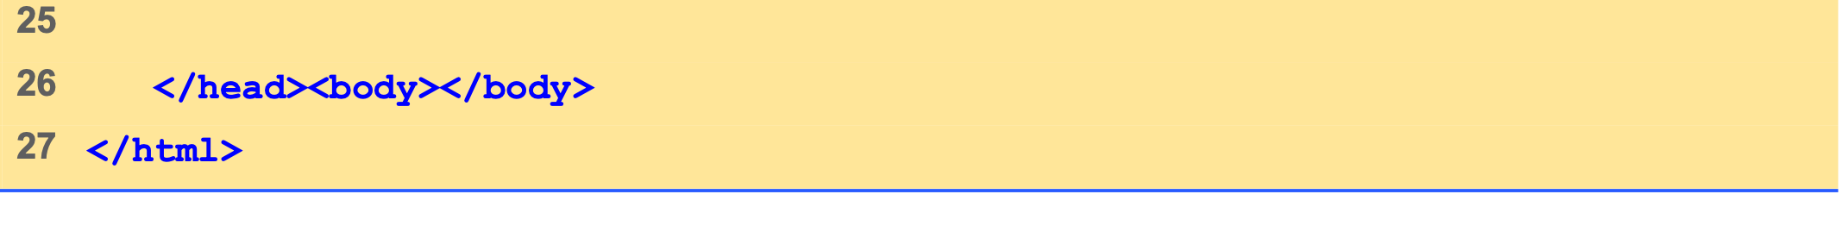
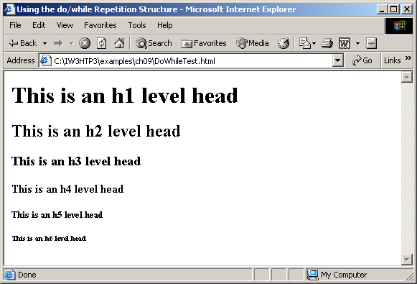
DoWhileTest.html (2 of 2)

Slide 27
6 do…while Repetition Structure
action(s)
true
condition
false

Slide 28
7 break and continue Statements
break
Immediate exit from the structure
Used to escape early from a loop
Skip the remainder of a switch statement
continue
Skips the remaining statements in the body of the structure
Proceeds with the next iteration of the loop

Slide 29
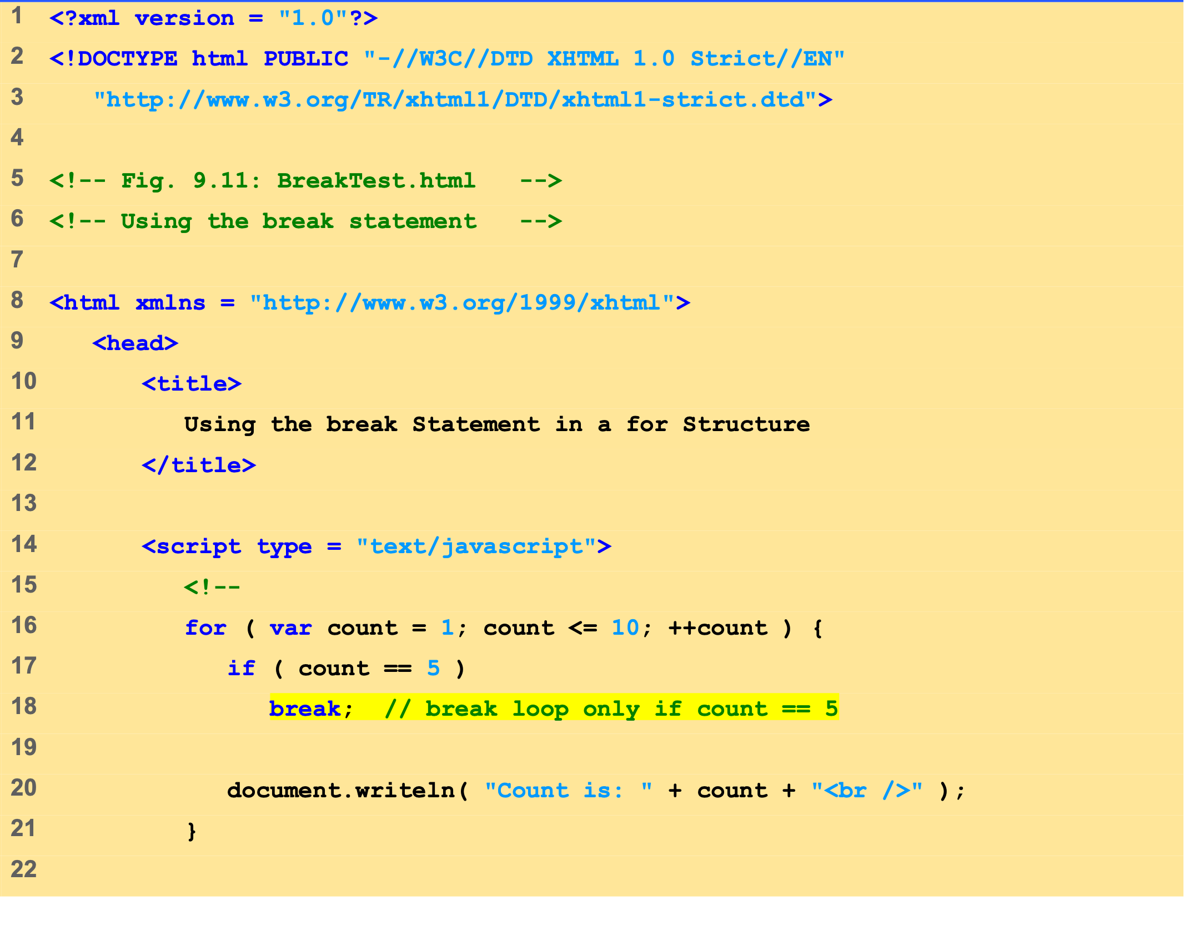
BreakTest.html (1 of 2)

Slide 30
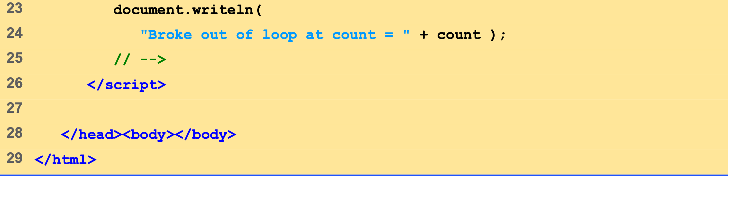
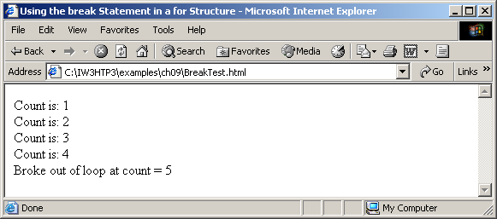
BreakTest.html (2 of 2)

Slide 31
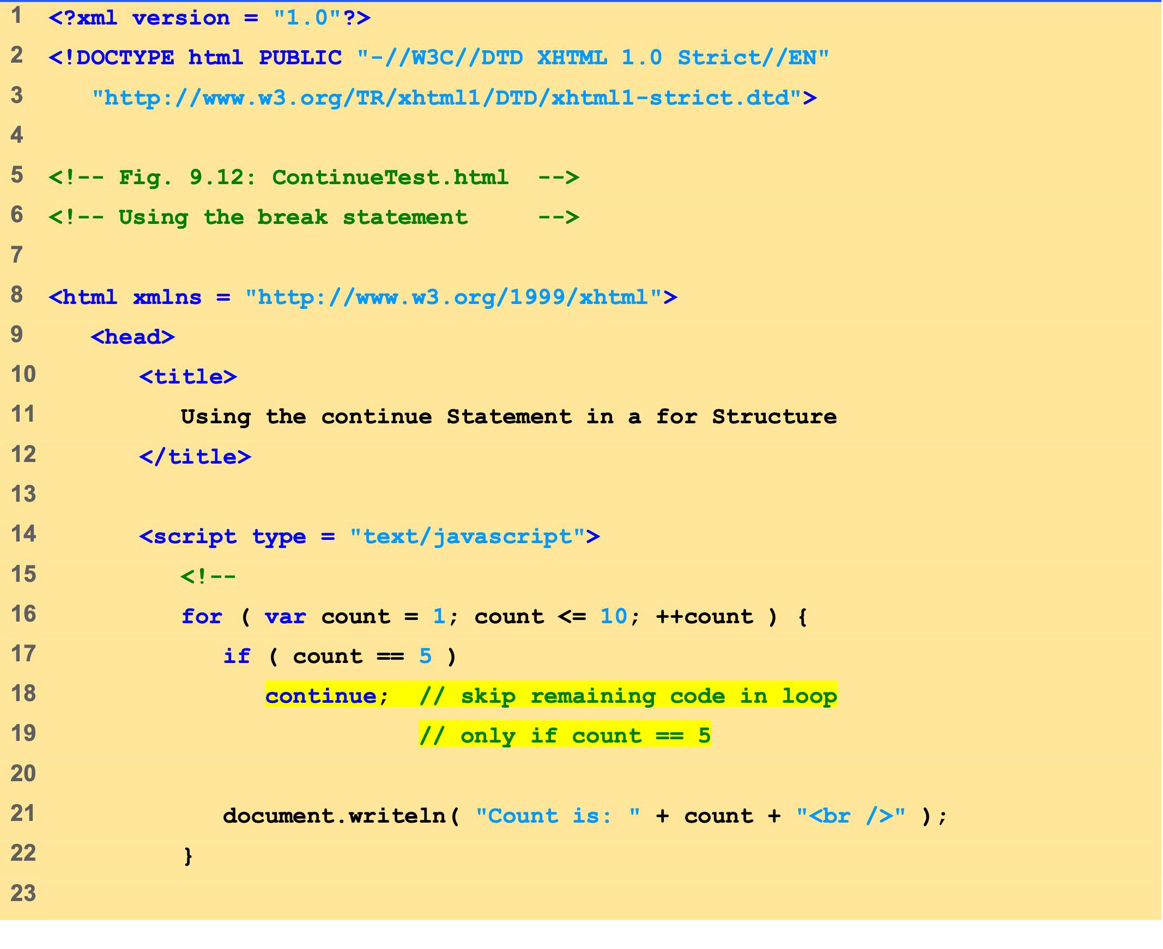
ContinueTest.html (1 of 2)

Slide 32
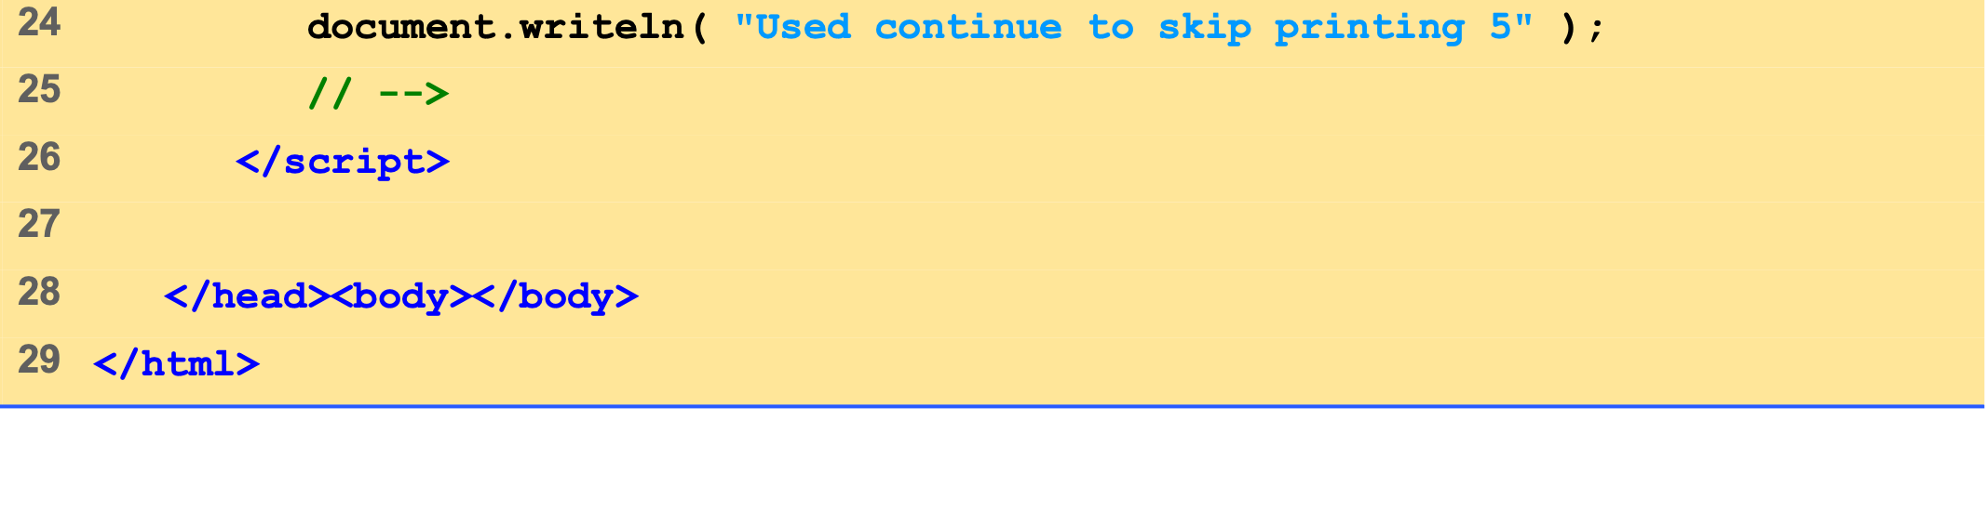
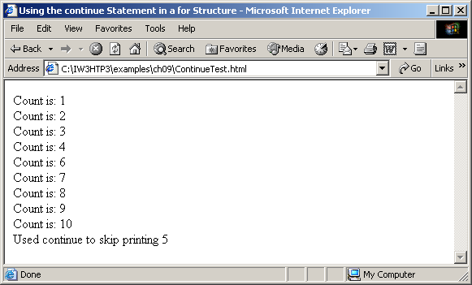
ContinueTest.html (2 of 2)

Slide 33
8 Labeled break and continue Statements
Labeled break statement
Break out of a nested set of structures
Immediate exit from that structure and enclosing repetition structures
Execution resumes with first statement after enclosing labeled statement
Labeled continue statement
Skips the remaining statements in structure’s body and enclosing repetition structures
Proceeds with next iteration of enclosing labeled repetition structure
Loop-continuation test evaluates immediately after the continue statement executes

Slide 34
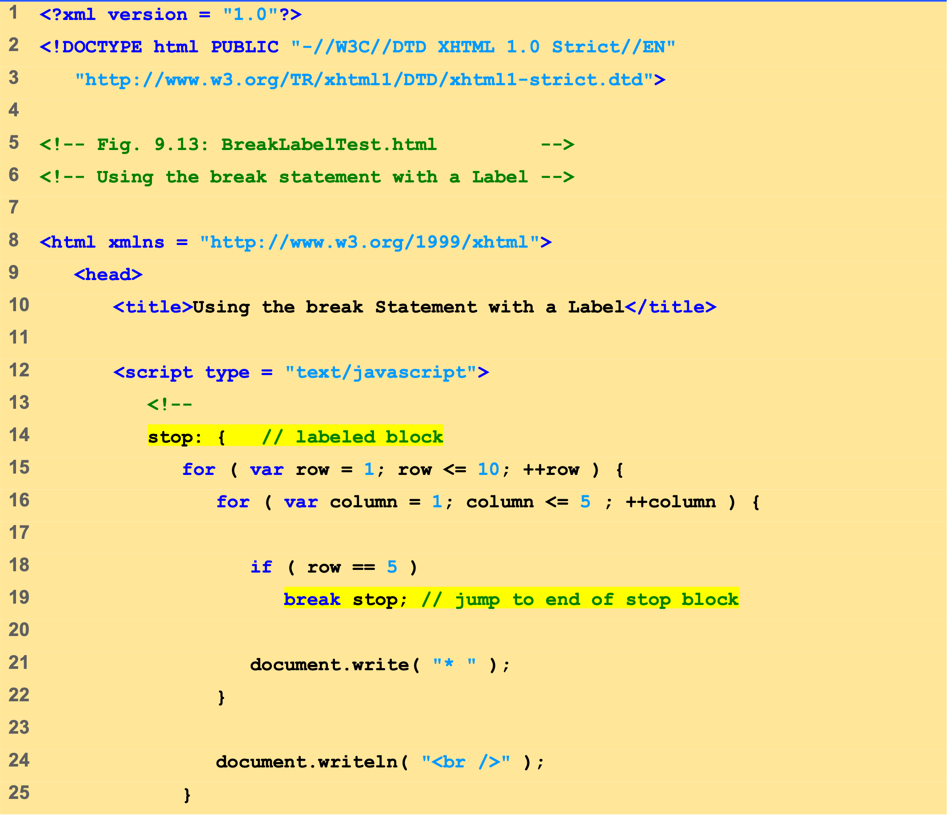
BreakLabelTest.html (1 of 2)

Slide 35
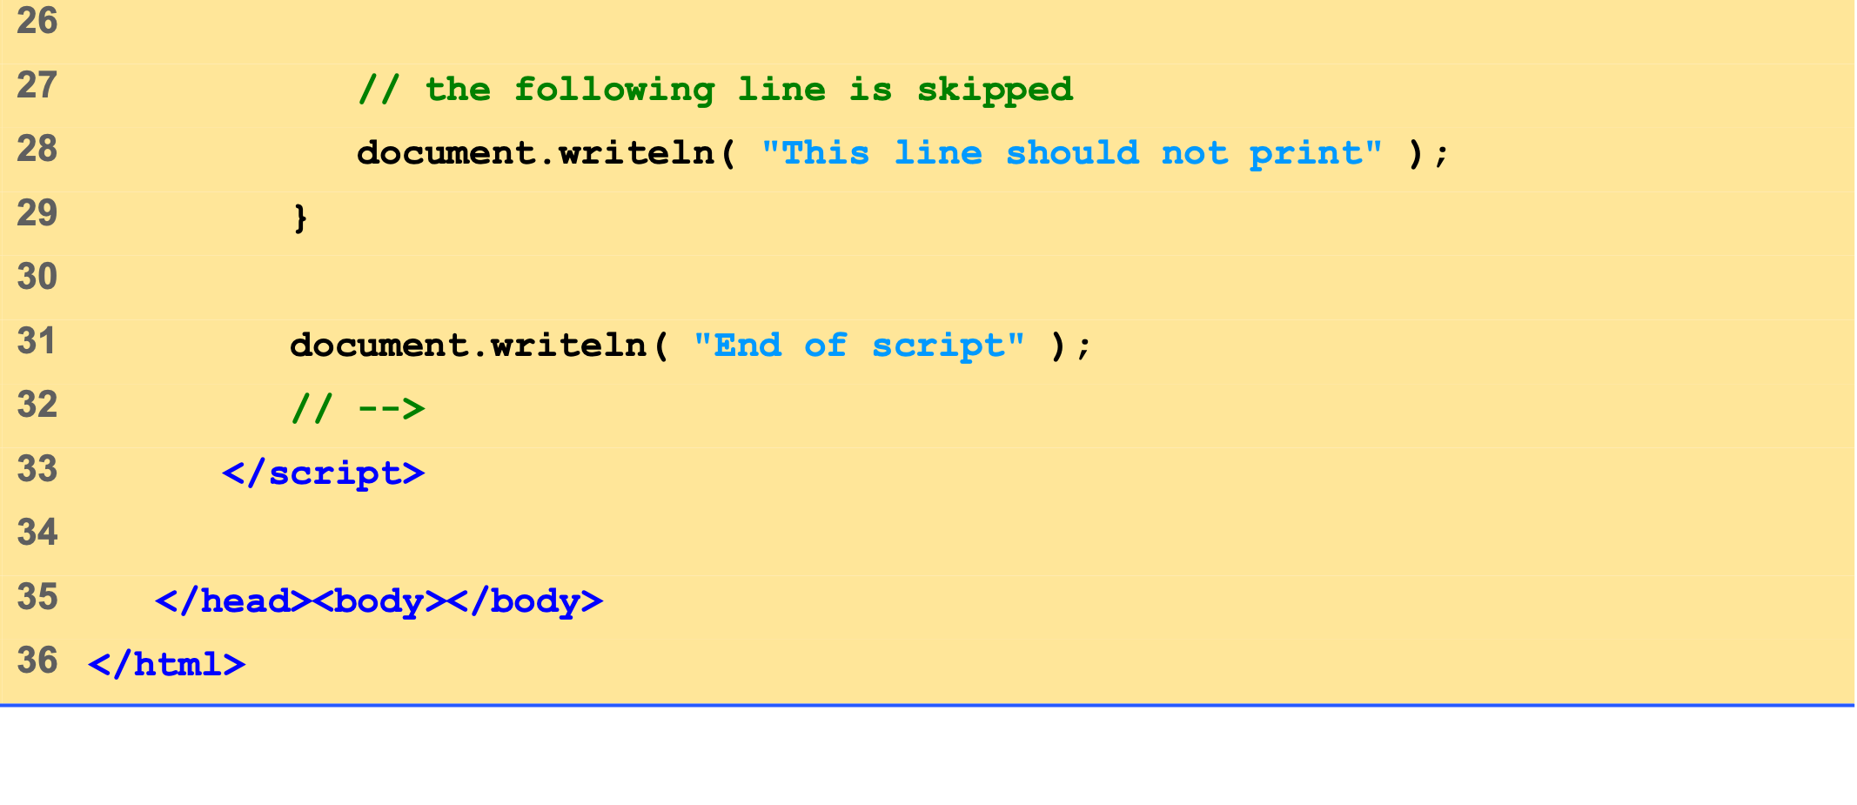
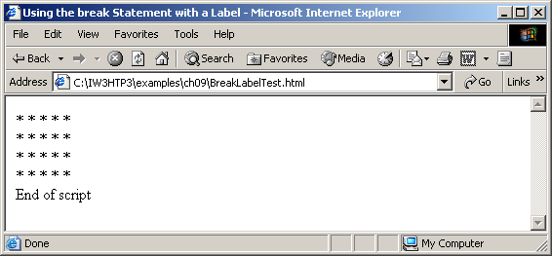
BreakLabelTest.html (2 of 2)

Slide 36
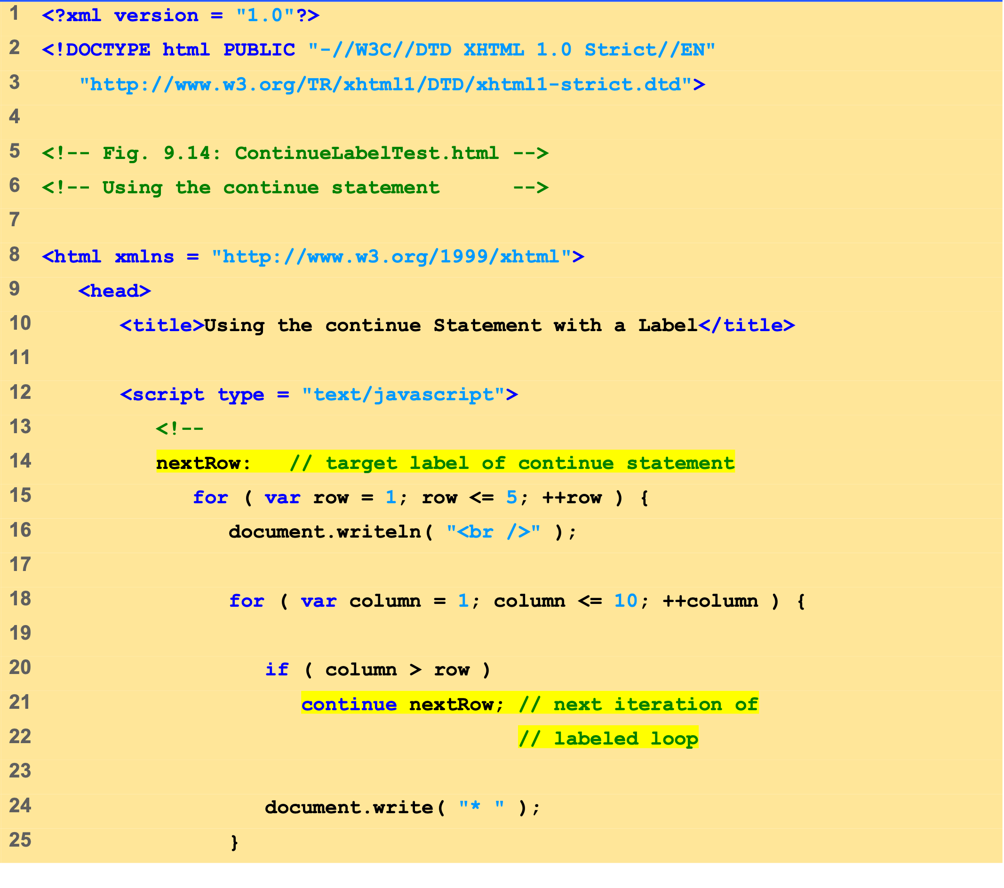
ContinueLabelTest.html (1 of 2)

Slide 37
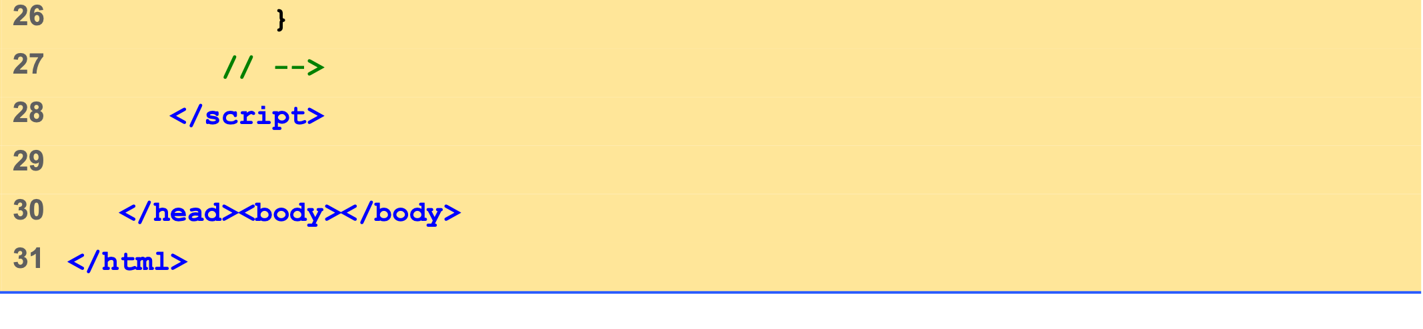
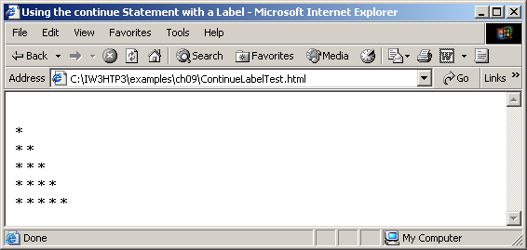
ContinueLabelTest.html (2 of 2)

Slide 38
9 Logical Operators
More logical operators
Logical AND ( && )
Logical OR ( || )
Logical NOT ( ! )

Slide 39
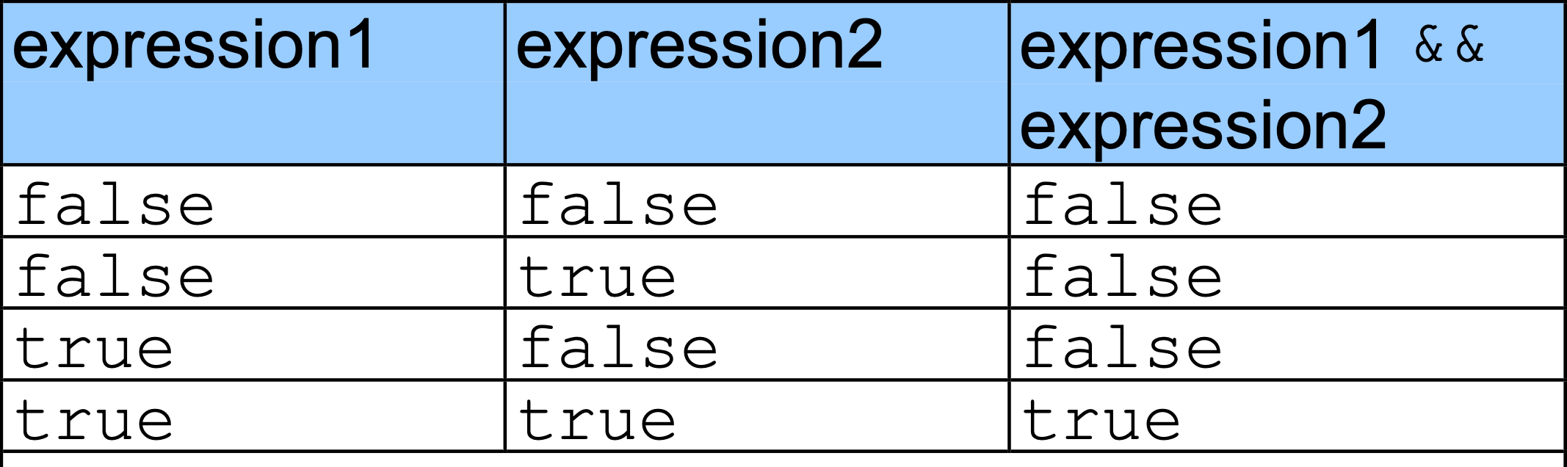
9 Logical Operators

Slide 40
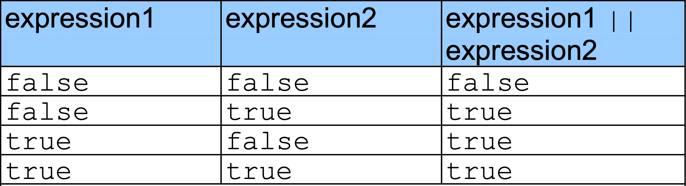
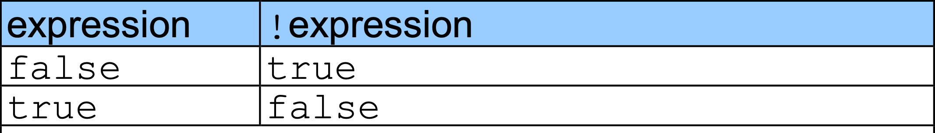
9 Logical Operators

Slide 41
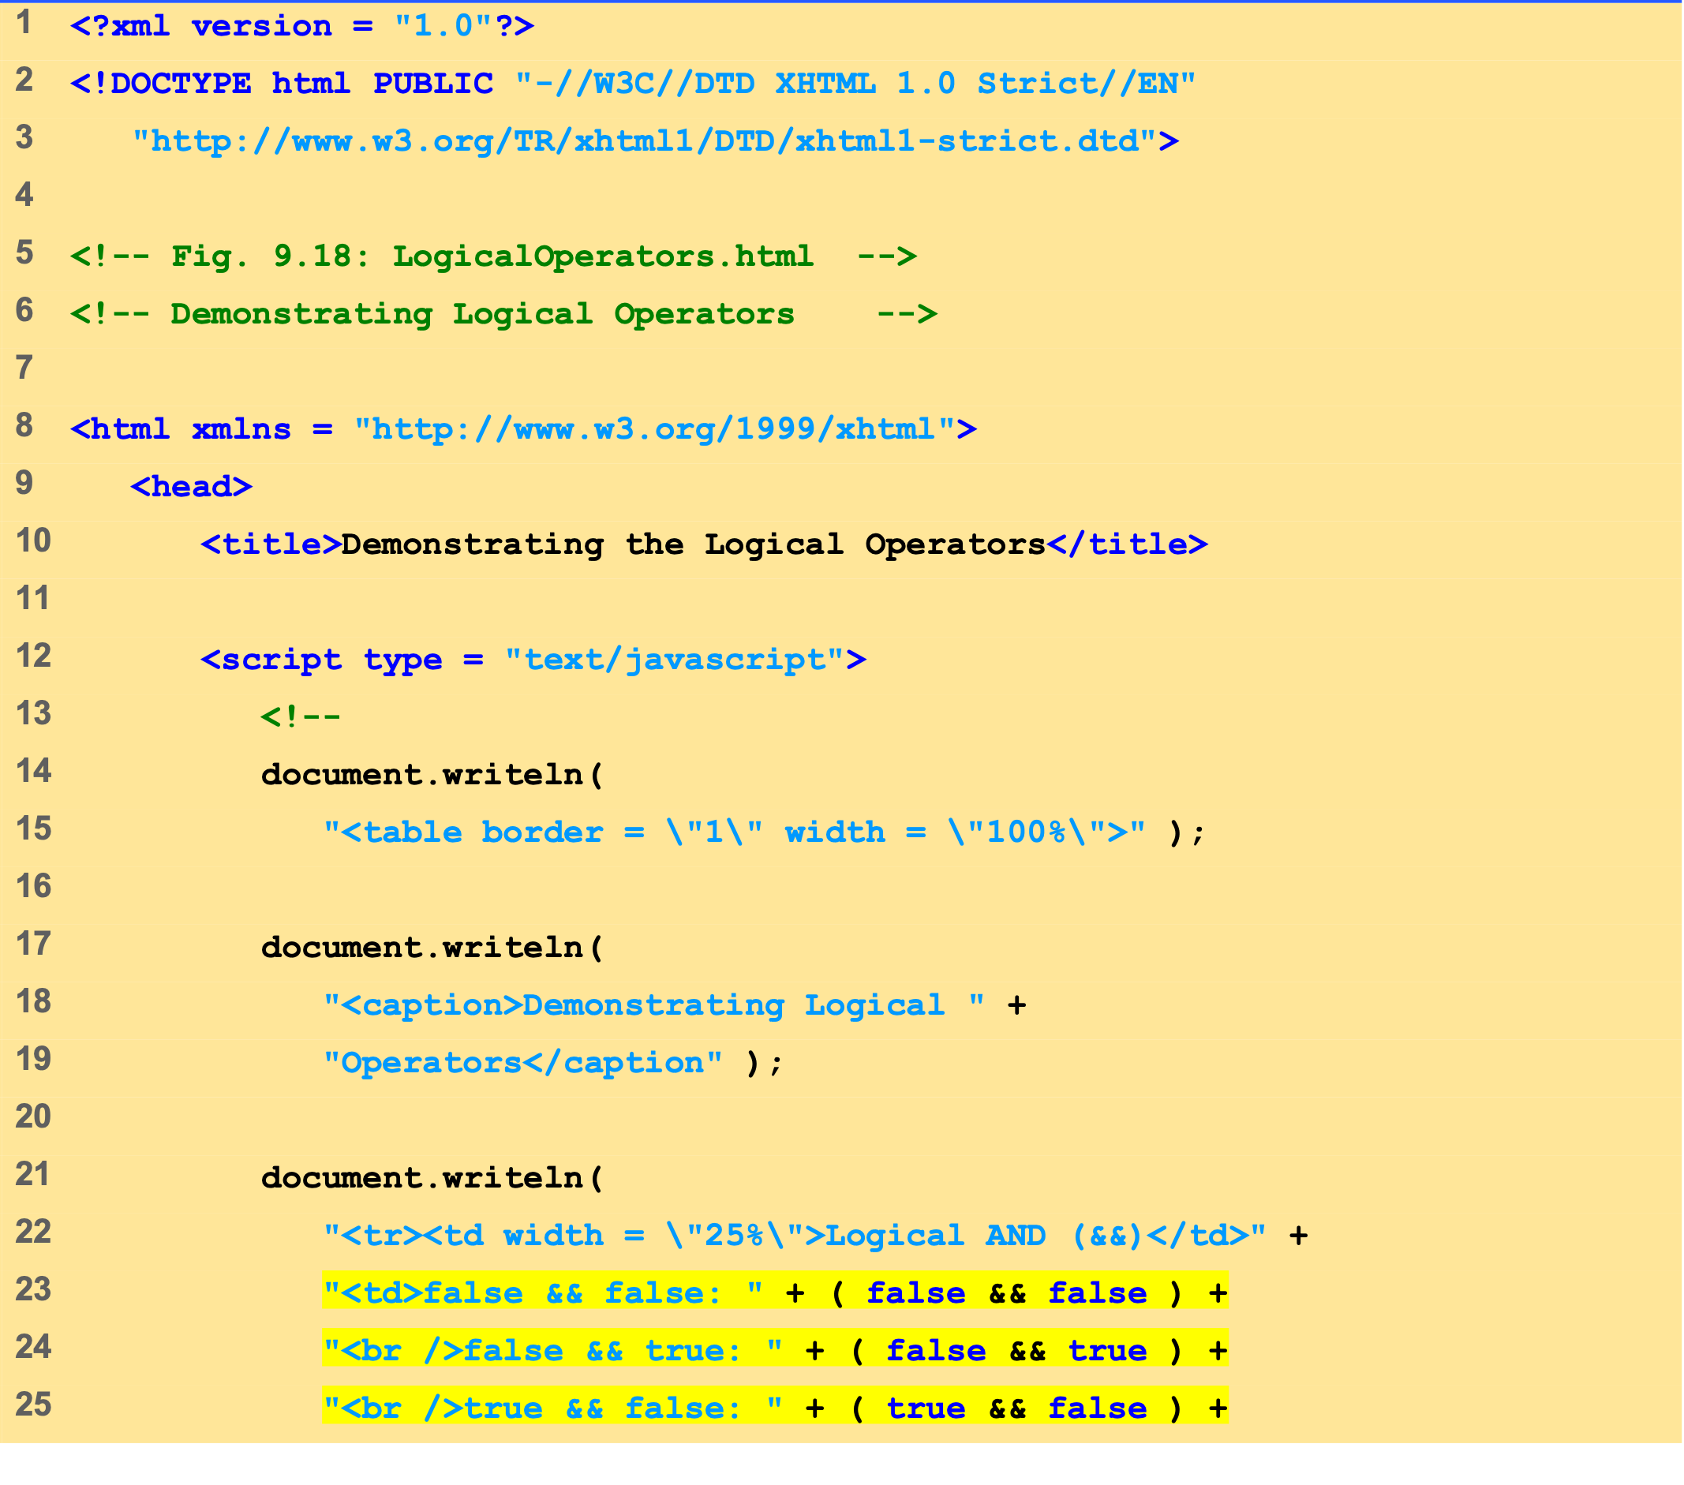
LogicalOperators.html (1 of 2)

Slide 42
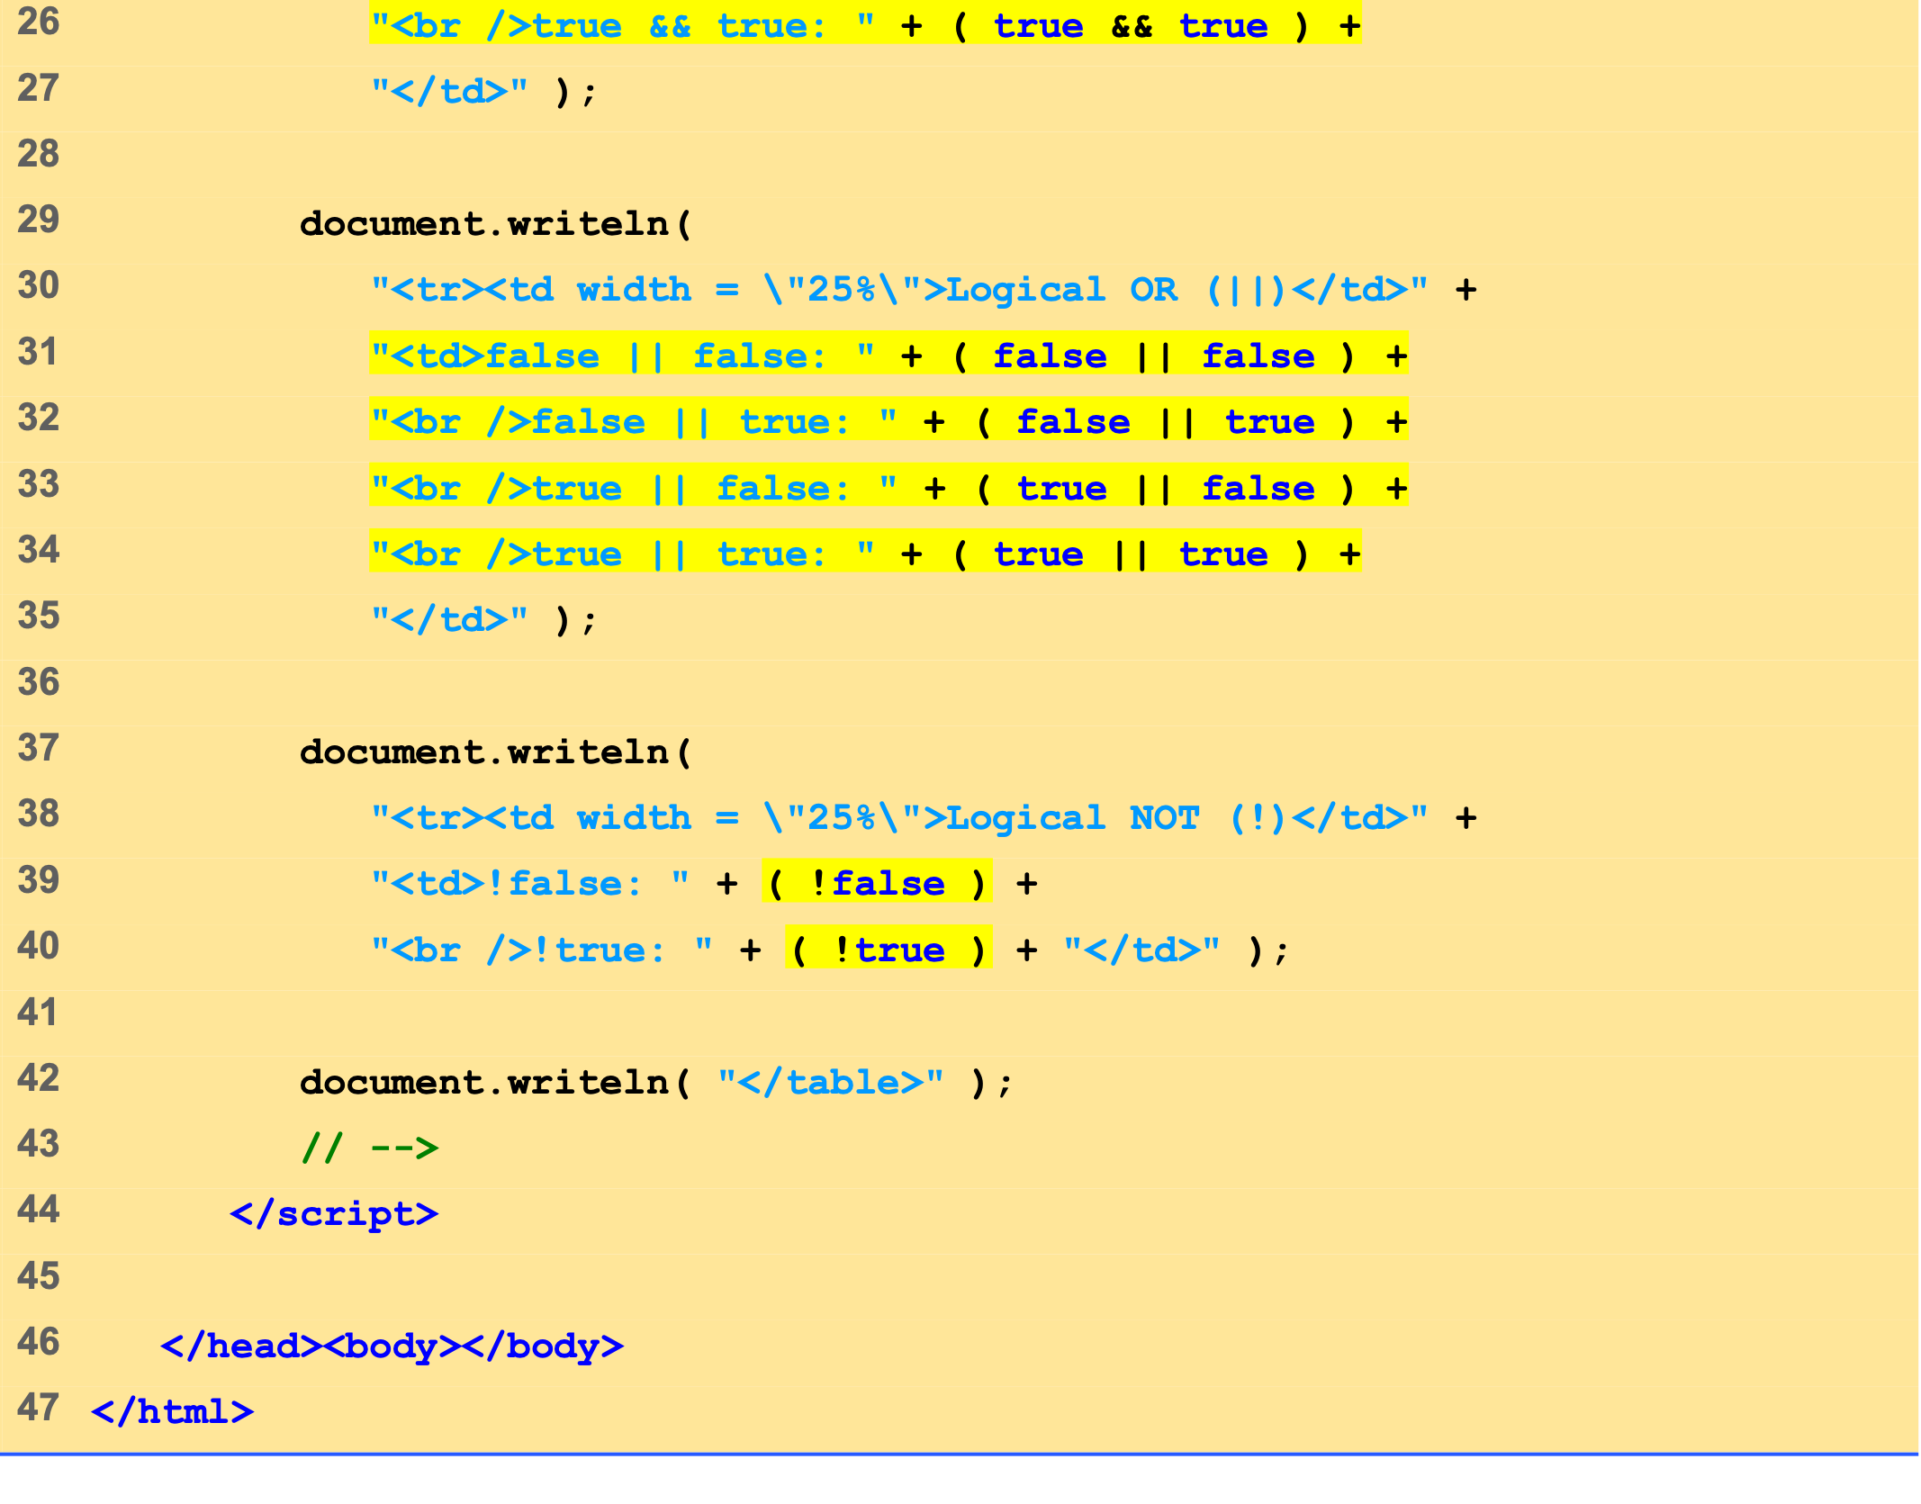
LogicalOperators.html (2 of 2)

Slide 43
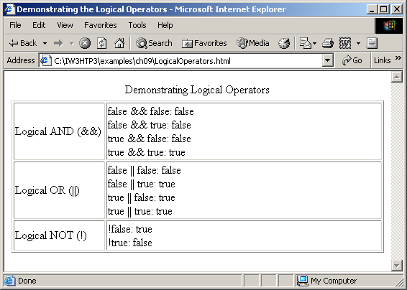

Slide 44
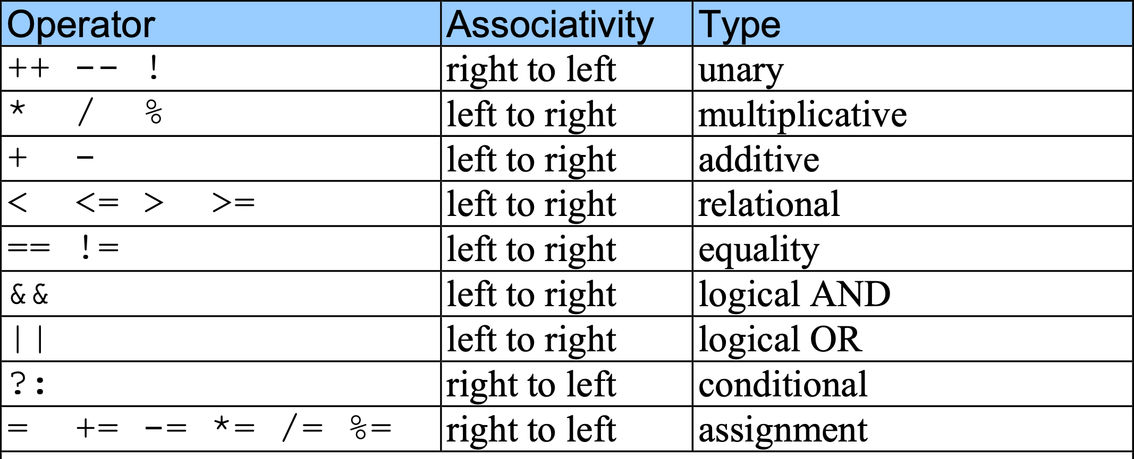
9 Logical Operators

Slide 45
10 Summary of Structured Programming
Flowcharts
Reveal the structured nature of programs
Single-entry/single-exit control structures
Only one way to enter and one way to exit each control structure
Control structure stacking
The exit point of one control structure is connected to the entry point of the next control structure

Slide 46
10 Summary of Structured Programming
statement
T
e
n
l
F
o
statement
i
i
h
t
w
i
t
…
e
o
p
e
d
e
l
R
i
T
T
h
statement
w
F
F
r
o
f

Slide 47
10 Summary of Structured Programming
)
n
o
i
statement
t
c
e
l
e
e
s
s
e
l
l
e
b
…
u
f
o
T
i
d
(
k
k
k
n
F
a
a
a
e
e
e
o
)
r
r
r
i
b
b
b
t
n
c
o
e
i
l
t
e
c
e
S
statement
l
)
e
n
s
o
e
i
h
l
t
c
p
c
i
t
e
t
l
l
i
u
e
w
T
T
T
statement
m
s
s
(
e
l
F
F
F
g
.
.
.
n
f
i
T
s
i
(
F

Slide 48
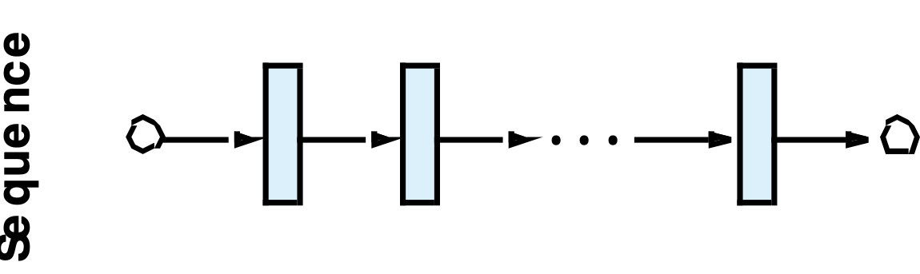
10 Summary of Structured Programming

Slide 49
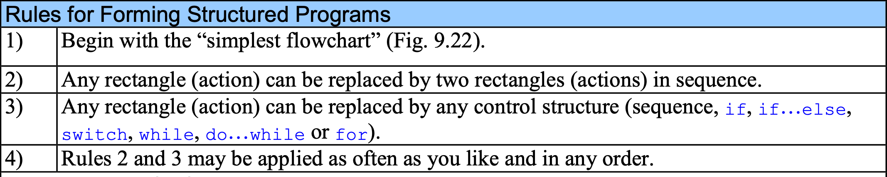
10 Summary of Structured Programming

Slide 50
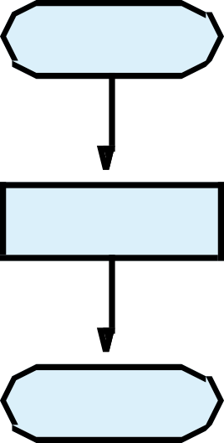
10 Summary of Structured Programming

Slide 51
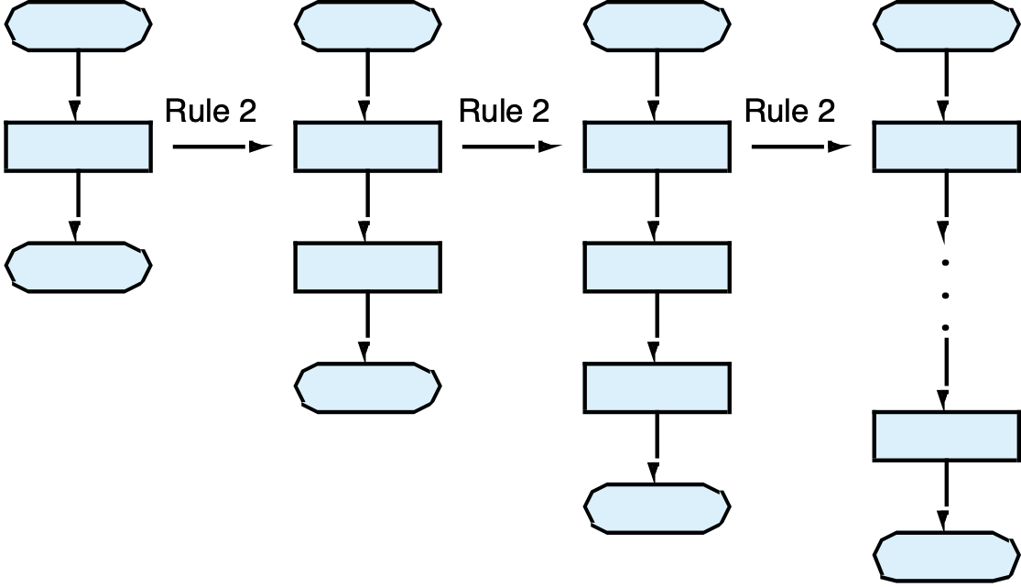
10 Summary of Structured Programming

Slide 52
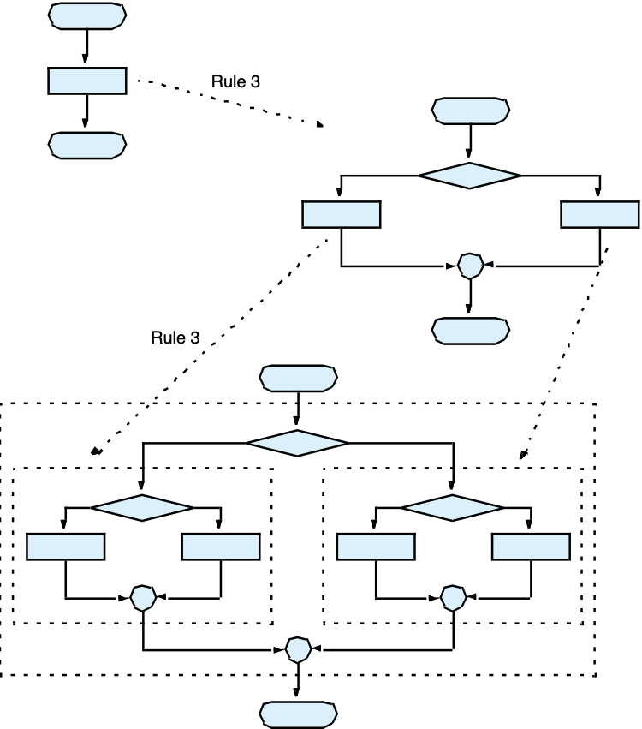
10 Summary of Structured Programming

Slide 53
10 Summary of Structured Programming
Stacked building blocks
Nested building blocks
Overlapping building blocks
(Illegal in structured programs)

Slide 54
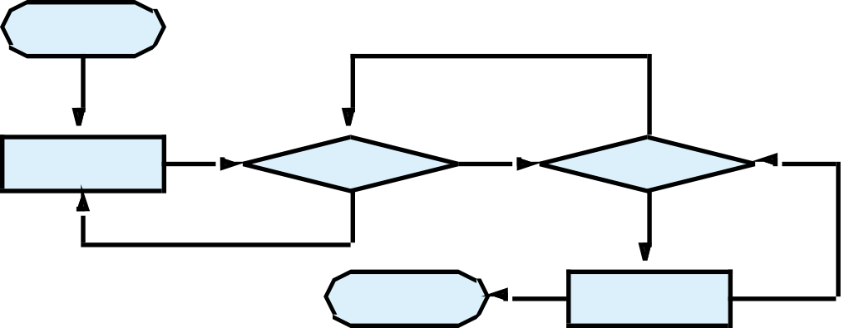
10 Summary of Structured Programming

Slide 55
Web Resources
www.javascriptmall.com
developer.netscape.com/tech/javascript
www.mozilla.org/js/language
Deitel and deitel, Internet and World Wide Web How to Program: Third Edition

